Slide 1

CROP RECOMMENDATION SYSTEM

Slide 2

OBJECTIVE
To develop a web-based automated crop recommendation system.
To leverage data-driven algorithms and user inputs in order to provide personalized and data-backed crop recommendations to farmers.
To enhance agricultural productivity, optimize resource utilization, and improve overall crop yield and income.

Slide 3

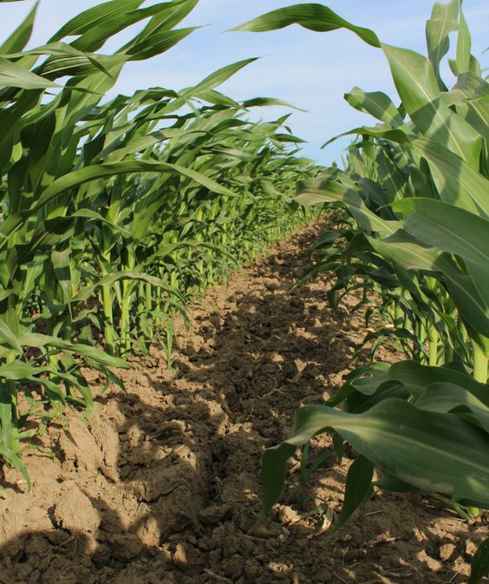
PROBLEM STATEMENT
Farmers and agricultural professionals often face challenges in selecting the most suitable crops for their specific agricultural areas due to varying environmental and soil conditions. Traditional methods of crop selection may not fully utilize available data and may not be efficient.
Therefore, there is a need for an automated Crop Recommendation System.
A system that leverages machine learning techniques to provide personalized crop recommendations based on Nitrogen, Phosphorus, Potassium , rainfall, temperature, humidity, and pH levels.
The system must also handle data preprocessing, model training and evaluation, and provide a user-friendly interface for easy access and interaction.

Slide 4
TECHNOLOGY
USED
PYTHON
HTML/CSS
FLASK
PICKLE
programming language used for model development, data preprocessing, and web application development.
Markup and styling languages used for designing the web interface.
A web framework used for building the user interface and handling HTTP requests.
A library used for maintaining persistence within complex data structures and objects
SCIKIT-LEARN
NUMPY
PANDAS
A library for numerical computing used for handling arrays and mathematical operations.
A data manipulation library used for data preprocessing and analysis.
A machine learning library used for model training, evaluation, and prediction.

Slide 5
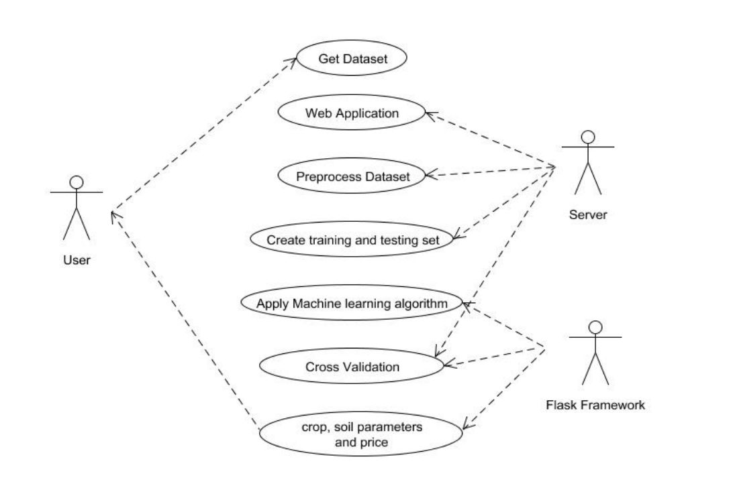
USE CASE DIAGRAM
crop reccomended based on soil parameters provided.

Slide 6
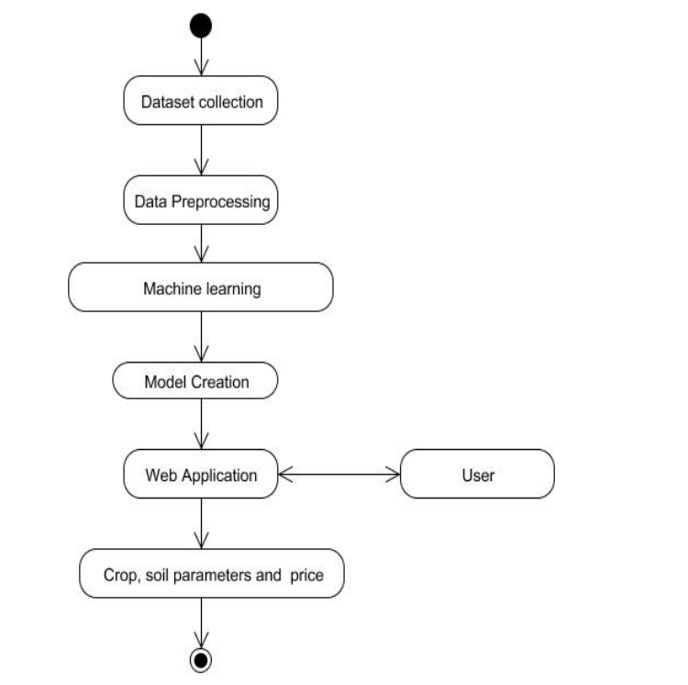
ACTIVITY DIAGRAM
Input required parameters

Slide 7
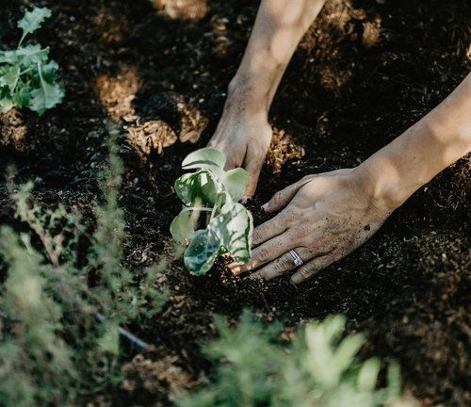
CONCLUSION
In conclusion, the development and implementation of our web-based automated crop recommendation system represent a significant step forward in modernizing and optimizing agricultural practices.
This project has been a journey of innovation, data-driven decision-making, and a commitment to enhancing the lives of farmers.
This project is not the end but rather the beginning of an ongoing commitment to refining and enhancing the system.

Slide 8


FUTURE ENHANCEMENTS
INTEGRATION OF REAL-TIME WEATHER DATA:
To improve the accuracy of recommendations by considering current weather conditions.
INCORPORATION OF CROP MARKET PRICES AND PROFITABILITY ANALYSIS:
To assist farmers in making economically viable decisions.
DEVELOPMENT OF A MOBILE APPLICATION
For convenient access and usage on smartphones and tablets.
INTEGRATION OF USER FEEDBACK AND DATA COLLECTION
To continuously enhance the recommendation system's performance by learning from user experiences and preferences.

Slide 9



PRESENTED BY
MOHIT FATING

